Slide 1
COLLEGE MANAGEMENT SYSTEM
WILL BE PRESENTED BY:
ABDUL RAFAY CT-012
MAHSHID FATIMA CT-023
NASHRA GHAFFAR CT-032
MEHAK HUSSAIN CT-030

Slide 2
introduction

Slide 3
PURPOSE
Automation of admission and enrolment.
Assistance in decision making.
To manage information of student, faculty and courses.
Consistently update information of all students.

Slide 4
FUNCTIONAL REQUIREMENTS
Log in Module (LM)
Administrator Module (AM)
Server Module (SM)
Normal Users Module (NUM)

Slide 5
NON-FUNCTIONAL REQUIREMENTS
Performance
Security
Maintainability
Availability
Portability

Slide 6
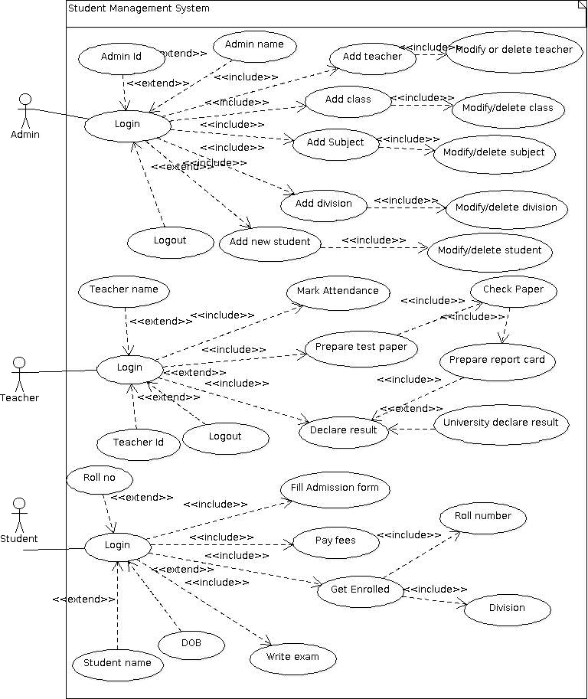
USE CASE

Slide 7
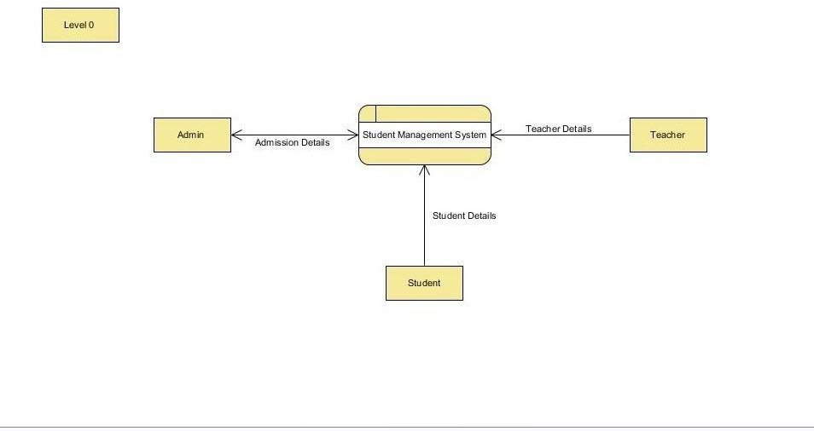
DATA FLOW DIAGRAM

Slide 8
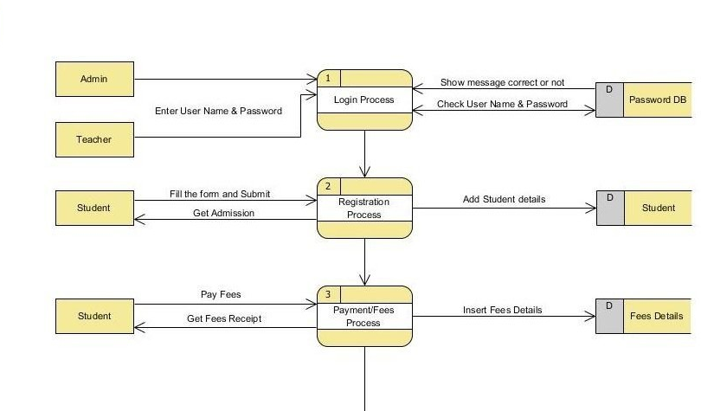
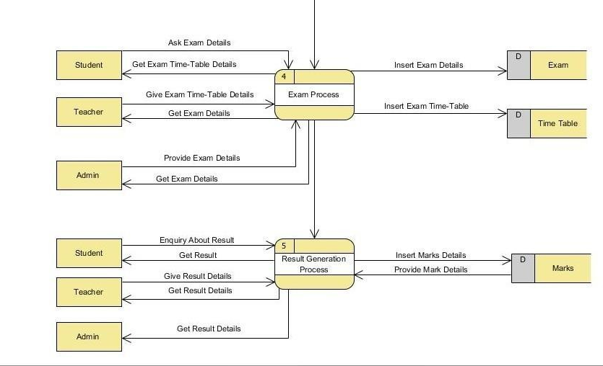
DATA FLOW DIAGRAM

Slide 9
DATA FLOW DIAGRAM

Slide 10
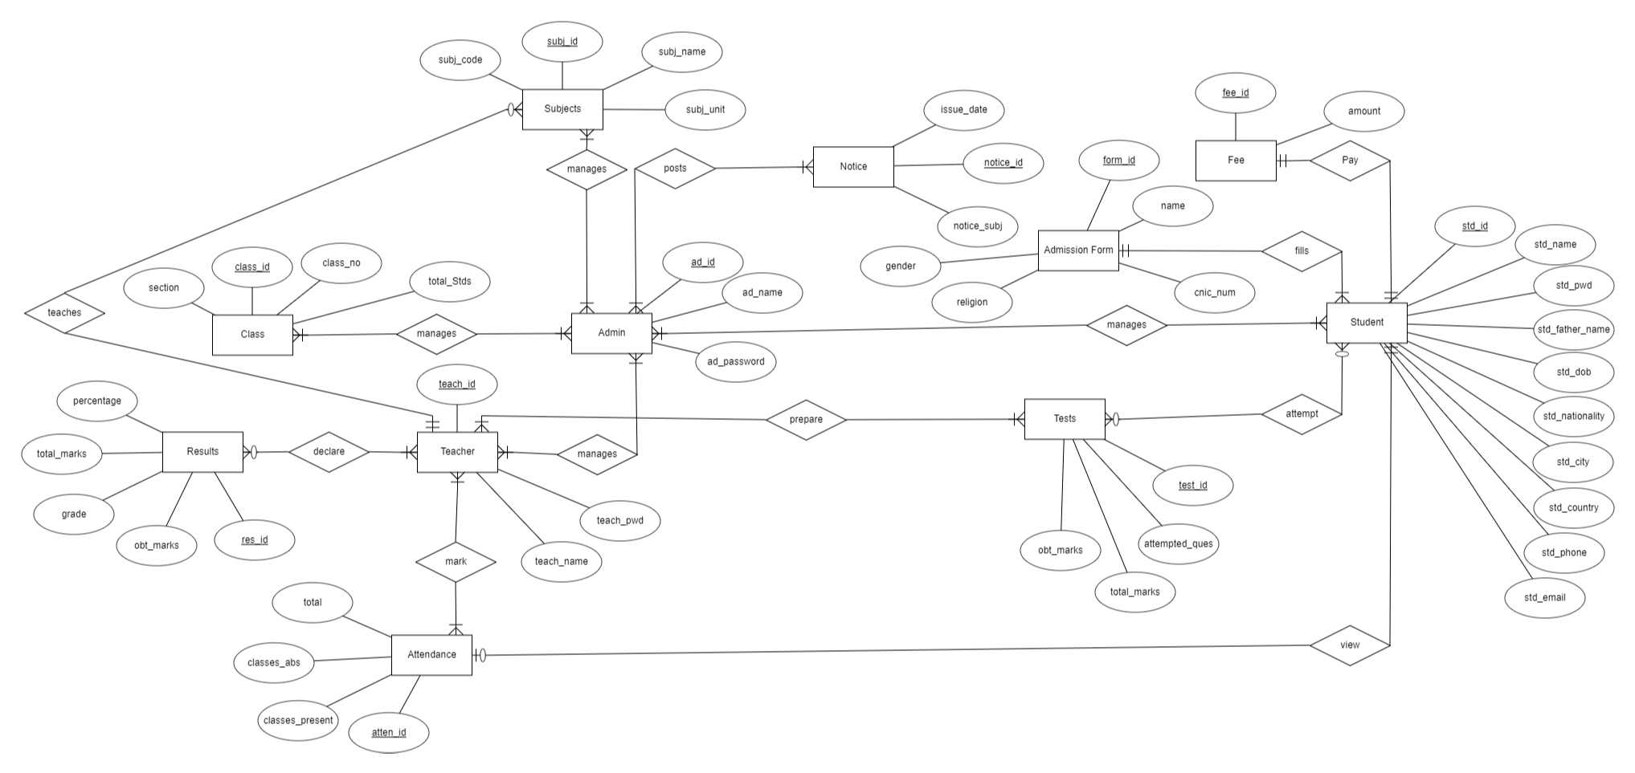
ER-DIAGRAM (LOGICAL)

Slide 11
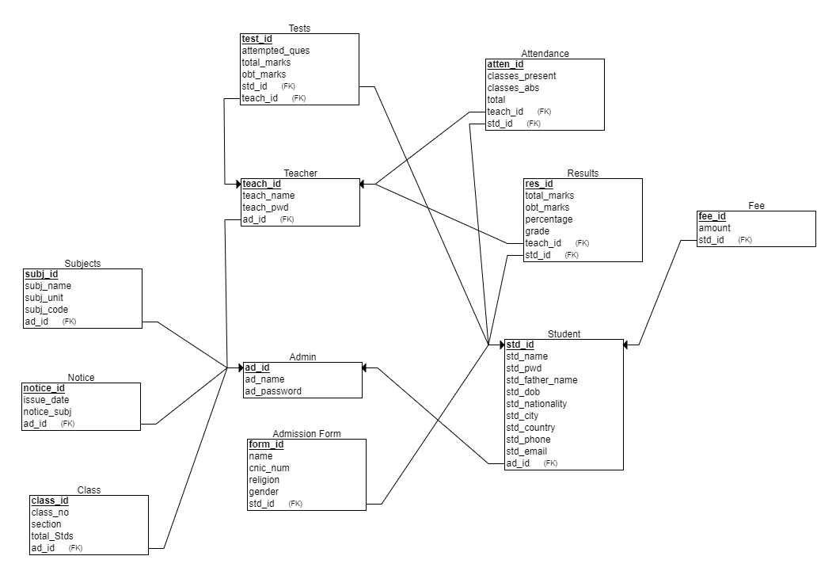
ER-DIAGRAM (PHYSICAL)

Slide 12
GENERAL CONSTRAINTS
Domain Integrity Constraint
Entity Integrity Constraint
Tuple Uniqueness Constraint
Referential Integrity Constraint

Slide 13
Our database

Slide 14
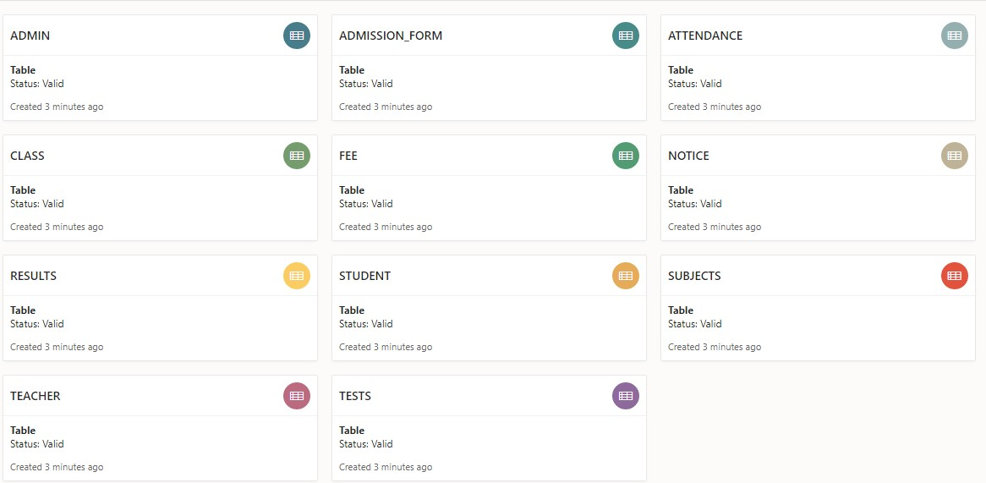

Slide 15
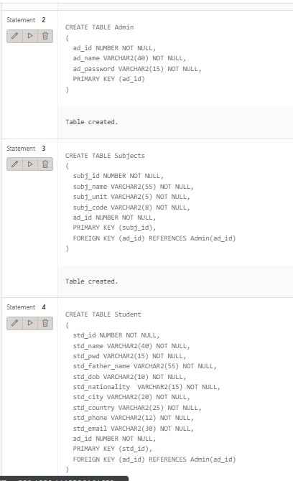
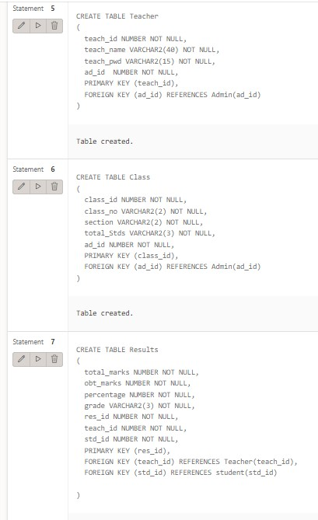

Slide 16
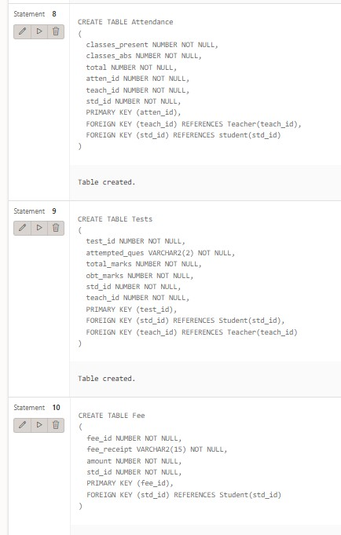
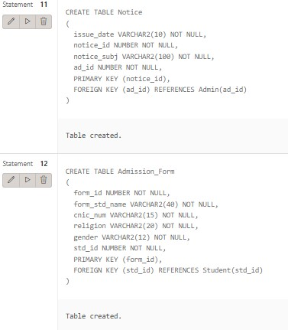

Slide 17
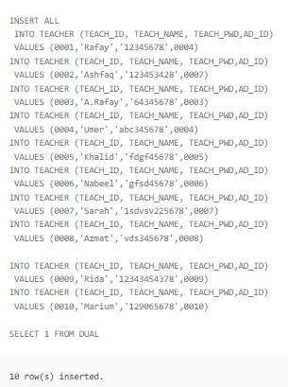
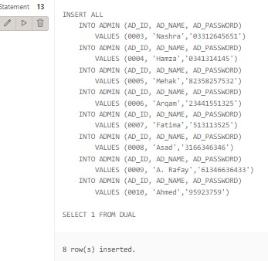
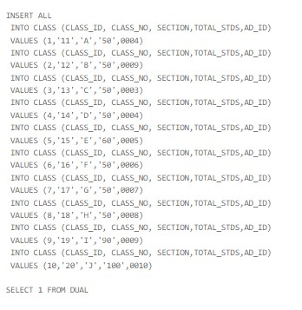

Slide 18
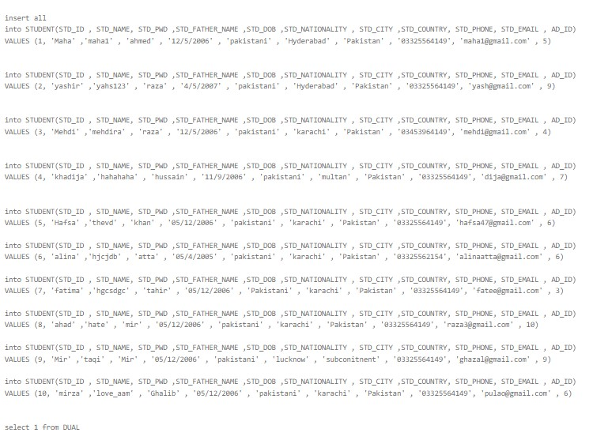

Slide 19
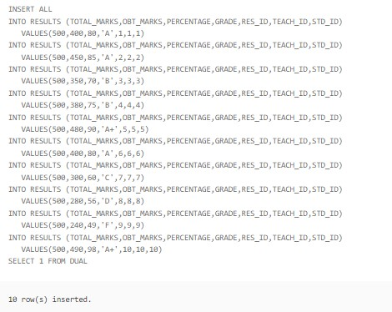
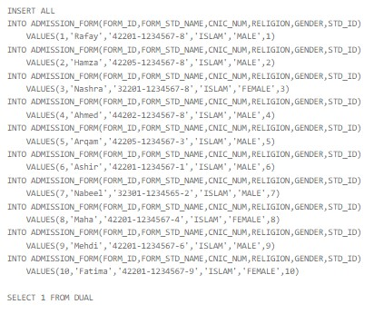
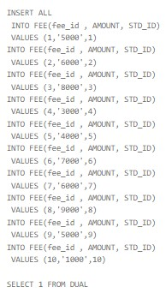

Slide 20
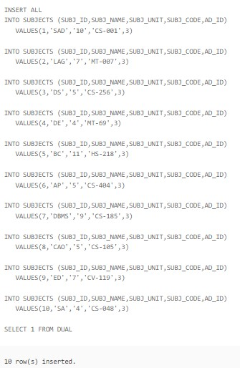
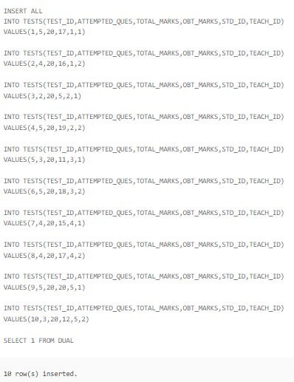
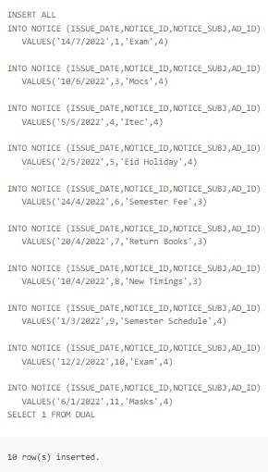

Slide 21
